Slide 1
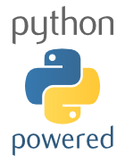
Programming Python
A blitz through programming concepts

Slide 2
Programming
Environment
Installed on the computer
10100101 -> 100010101010011110
Language
Installed in the human
These words and symbols, when put together have meaning to the computer

Slide 3
Programming
Programming is a way of thinking, not a rote skill.
People understand what they can see. If a programmer cannot see what a program is doing, he/she can't understand it.
Notes:
Learning about "for" loops is not learning to program, any more than learning about pencils is learning to draw.

Slide 4
The Environment
read the vocabulary
what do these words mean?
follow the flow
what happens when?
see the state
what is the computer thinking?
create by abstracting
start concrete, then generalize
Notes:
Should allow you to

Slide 5
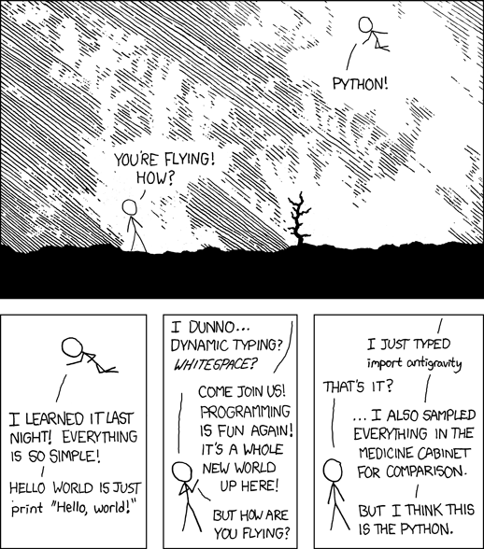
Why Python?
Powerful object oriented features
Great for text processing
Useful object types
Clean syntax
Powerful extensions
Large and active community
numpy/scipy/biopython

Slide 6

The Zen of Python
by Tim Peters
Beautiful is better than ugly.
Explicit is better than implicit.
Simple is better than complex.
Complex is better than complicated.
Flat is better than nested.
Sparse is better than dense.

Slide 7
The Zen of Python
by Tim Peters
Readability counts.
Special cases aren't special
enough to break the rules.
Although practicality beats purity.
Errors should never pass silently,
Unless explicitly silenced.

Slide 8
The Zen of Python
by Tim Peters
In the face of ambiguity, refuse the temptation to guess.
There should be one-- and preferably only one --obvious way to do it.
Although that way may not be obvious at first unless you're Dutch.
Now is better than never.
Although never is often better than *right* now.

Slide 9
The Zen of Python
by Tim Peters
If the implementation is hard to explain, it's a bad idea.
If the implementation is easy to explain, it may be a good idea.
Namespaces are one honking great idea -- let's do more of those!

Slide 10
Some useful python distributions
http://www.python.org/
Reference implementation with standard libraries, that’s it!
anaconda
Pre-packaged scientific goodies
Paid version with extras
http://continuum.io/downloads
enthought canopy
Pre-packaged scientific goodies
Integrated IDE/package manager
Paid version with extras (free for academics)
pythonxy
Windows only
Many scientific computing goodies
https://code.google.com/p/pythonxy/

Slide 11
Some useful python environments
Komodo Edit
http://www.activestate.com/komodo-edit
PyCharm
http://www.jetbrains.com/pycharm/
PythonTutor
http://www.pythontutor.com

Slide 12
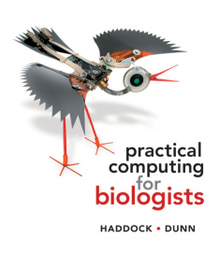
An Excellent Book
Reformatting data with regex
The Unix command line
Combining and automating analyses
Python programming and debugging
Creating and editing graphics
Databases
Performing analyses remotely

Slide 13
Object Oriented Programming
Objects hold information
They can contain values
They can contain multiple values
They can contain other objects
They have types
They can inherit information from others

Slide 14
Some Python Object Types
Numbers
Integers (whole numbers): 7
Floating point numbers: 7.7
String
Sequence of characters: “word!”
Set
Unordered and unique collection of objects

Slide 15
Some Python Object Types
List
An ordered list of objects:
[2, 4, 7, 22]
[“acgta”, “gtaagt”]
Dictionary
“associative arrays”
A collection of key -> values
{“age”:13, “address”: “123 street”}

Slide 16
Programming Logic
If/else
Conditional logic!
Allows you to control the flow of behavior
If it rains today
For or while loops
Do something several times
Make sure you understand when or if things stop!

Slide 17
Functions
Modularized sets of instructions you can re-use
Mini-programs
Do something or return an object
run_pcr(DNA_source=“”,
program=touchdown,
forward_primer=“ITS1-F”,
forward_primer=“ITS1-R”)

Slide 18
Namespaces (“Frames”)
Abstract container for your objects
Context for names of things
Analogy: file and folder names

Slide 19
Interactive tutorial

Slide 20
Group assignment
Write a python script that outputs the numbers 1 to 30

Slide 21
Group assignment
Write a python script that outputs the numbers 1 to 30, replacing any number divisible by 3 with the word “evolution”

Slide 22
Group assignment
Write a python script that outputs the numbers 1 to 30, replacing any number divisible by 3 with the word “evolution” and any number divisible by 5 with the word “ecology”

Slide 23
My solution
for number in range(1,30):
if number % 15 == 0:
out = "evolution and ecology"
elif number % 3 == 0:
out = "evolution"
elif number % 5 == 0:
out = "ecology"
else:
out = str(number)
print(out)

Slide 24

Can parse data files into Python
Blast output, fasta, GenBank, Etc
Interfaces to common programs
Blast, clustalw, EMBOSS, phylip, genepop
Some built-in functions for manipulation
Extensive documentation
http://biopython.org/DIST/docs/tutorial/Tutorial.html

